Slide 1
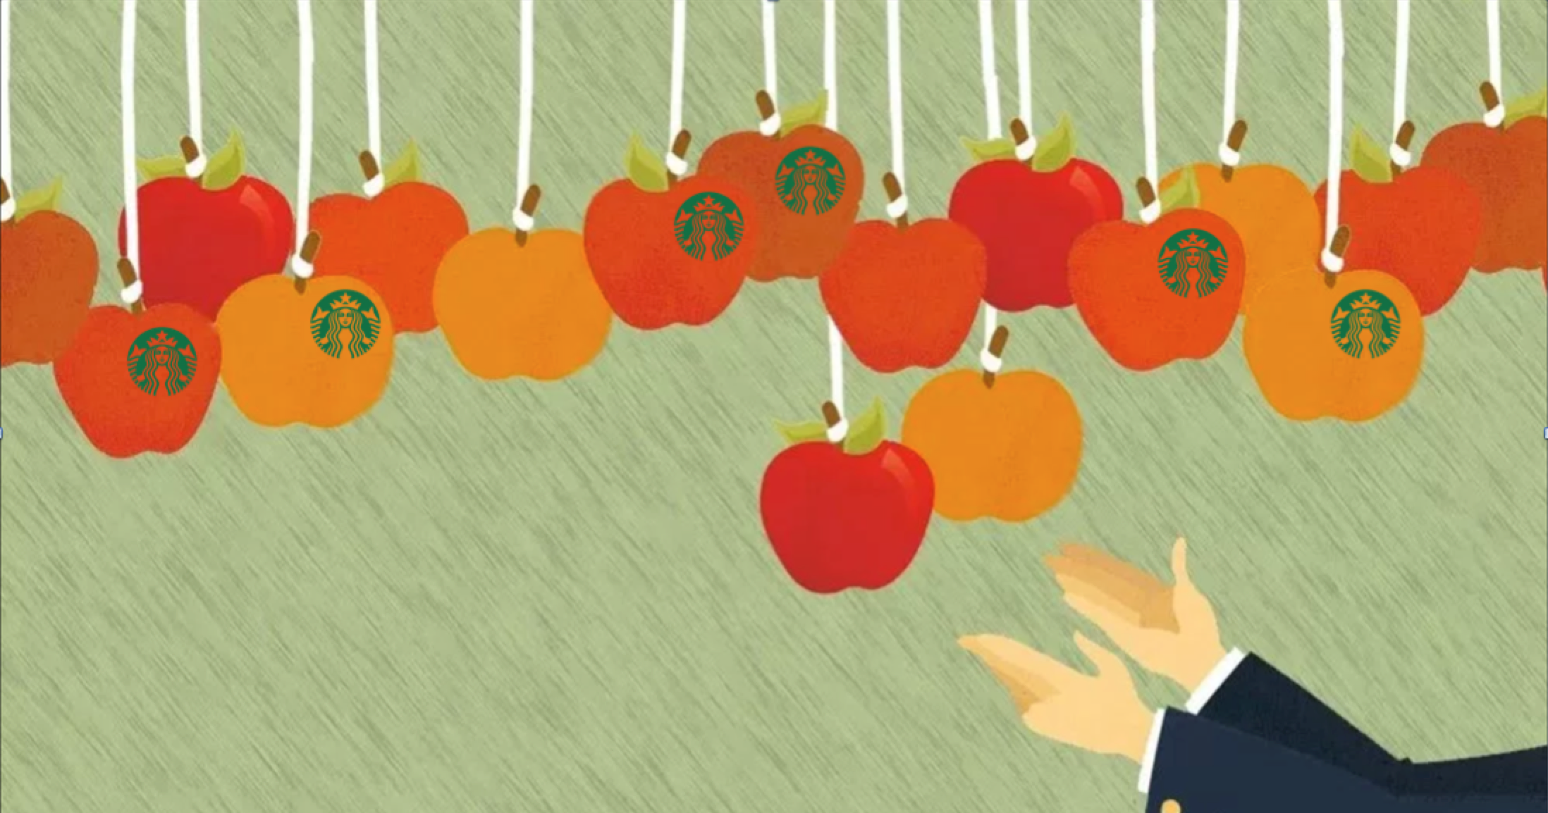
Room For One More?

Slide 2
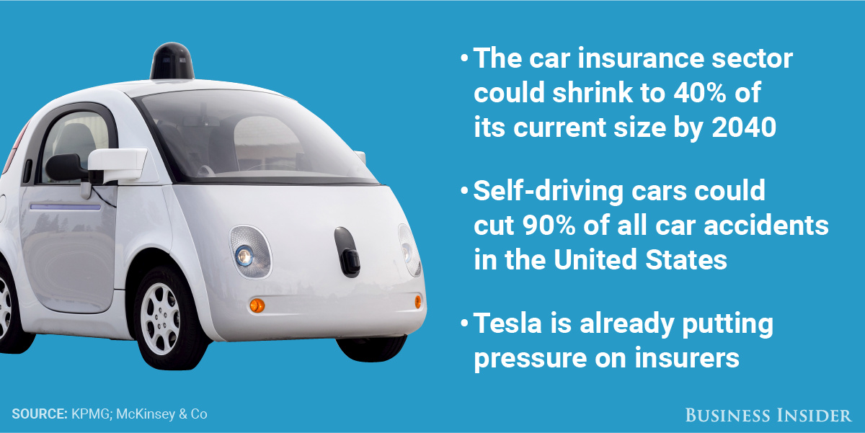
The Problem: Autonomous Cars have Negative Impact on Auto Insurance Industry

Slide 3
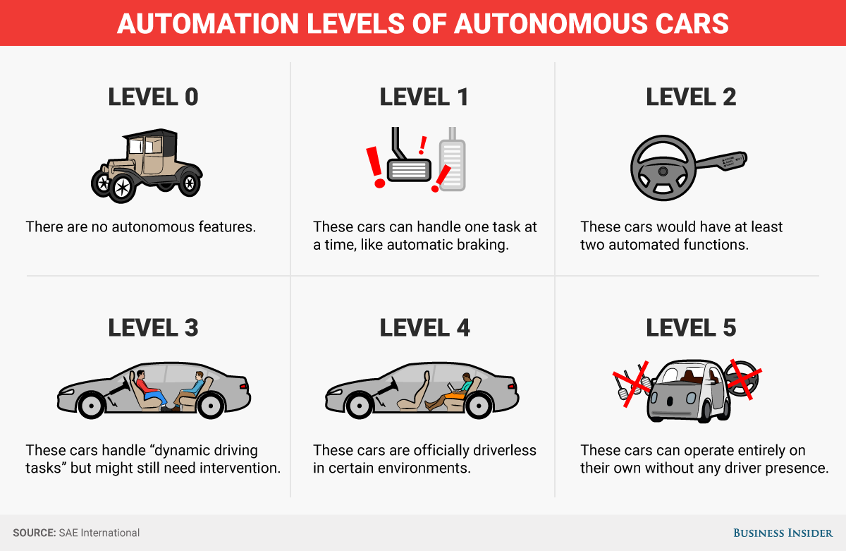
As Humans begin to take a backseat to driving, who's at fault?

Slide 4
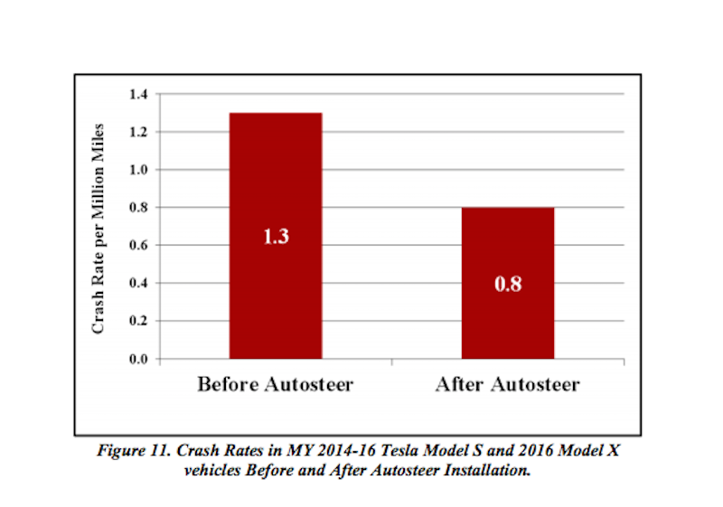
Human error is playing a smaller role

Slide 5
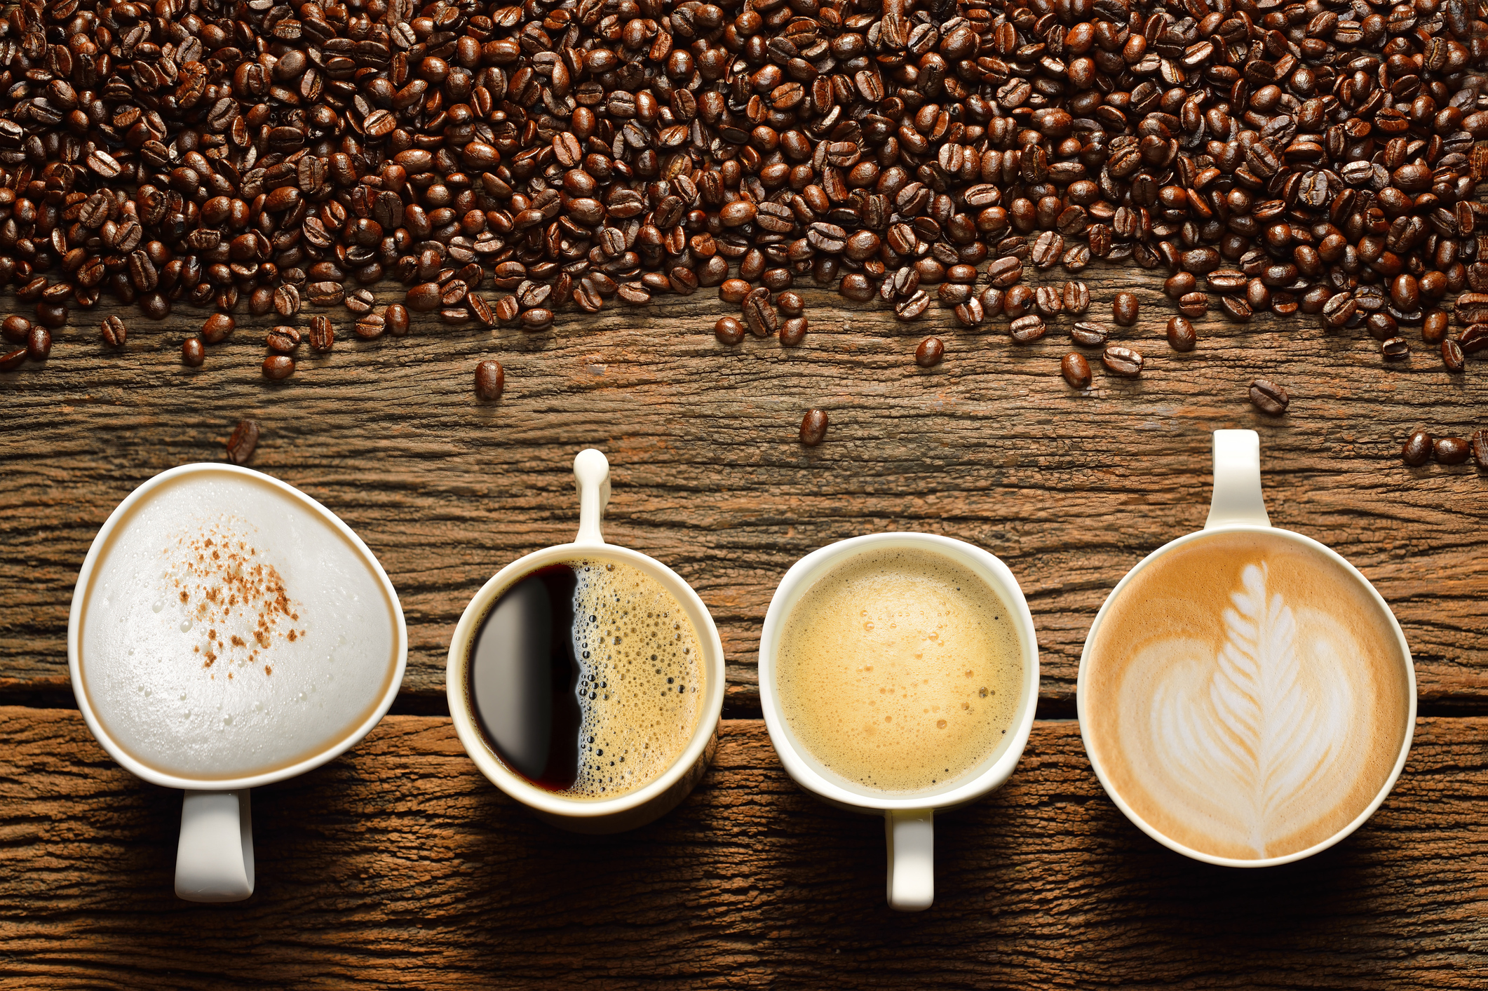
Is Coffee the Answer?

Slide 6
It Turns out, There's Plenty of Low-Hanging Fruit

Slide 7
How do we Compete Against Starbucks?
• Which zip codes are great for coffee shops?
• Which zip codes are saturated by Starbucks stores?
• Which zip codes have room for competition?

Slide 8
Which Zip Codes are Great for Coffee Shops?

Slide 9
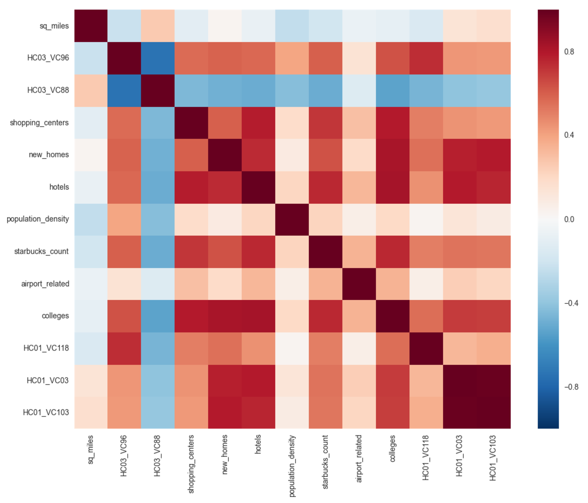
Which Zip Codes are Great for Coffee Shops?

Slide 10
Variables of Interest
1) Percent of citizens with high school diploma but no degree
2) Percent of citizens with bachelor's degree or higher
3) Population Density
4) Number of new homes
5) Number of hotels

Slide 11
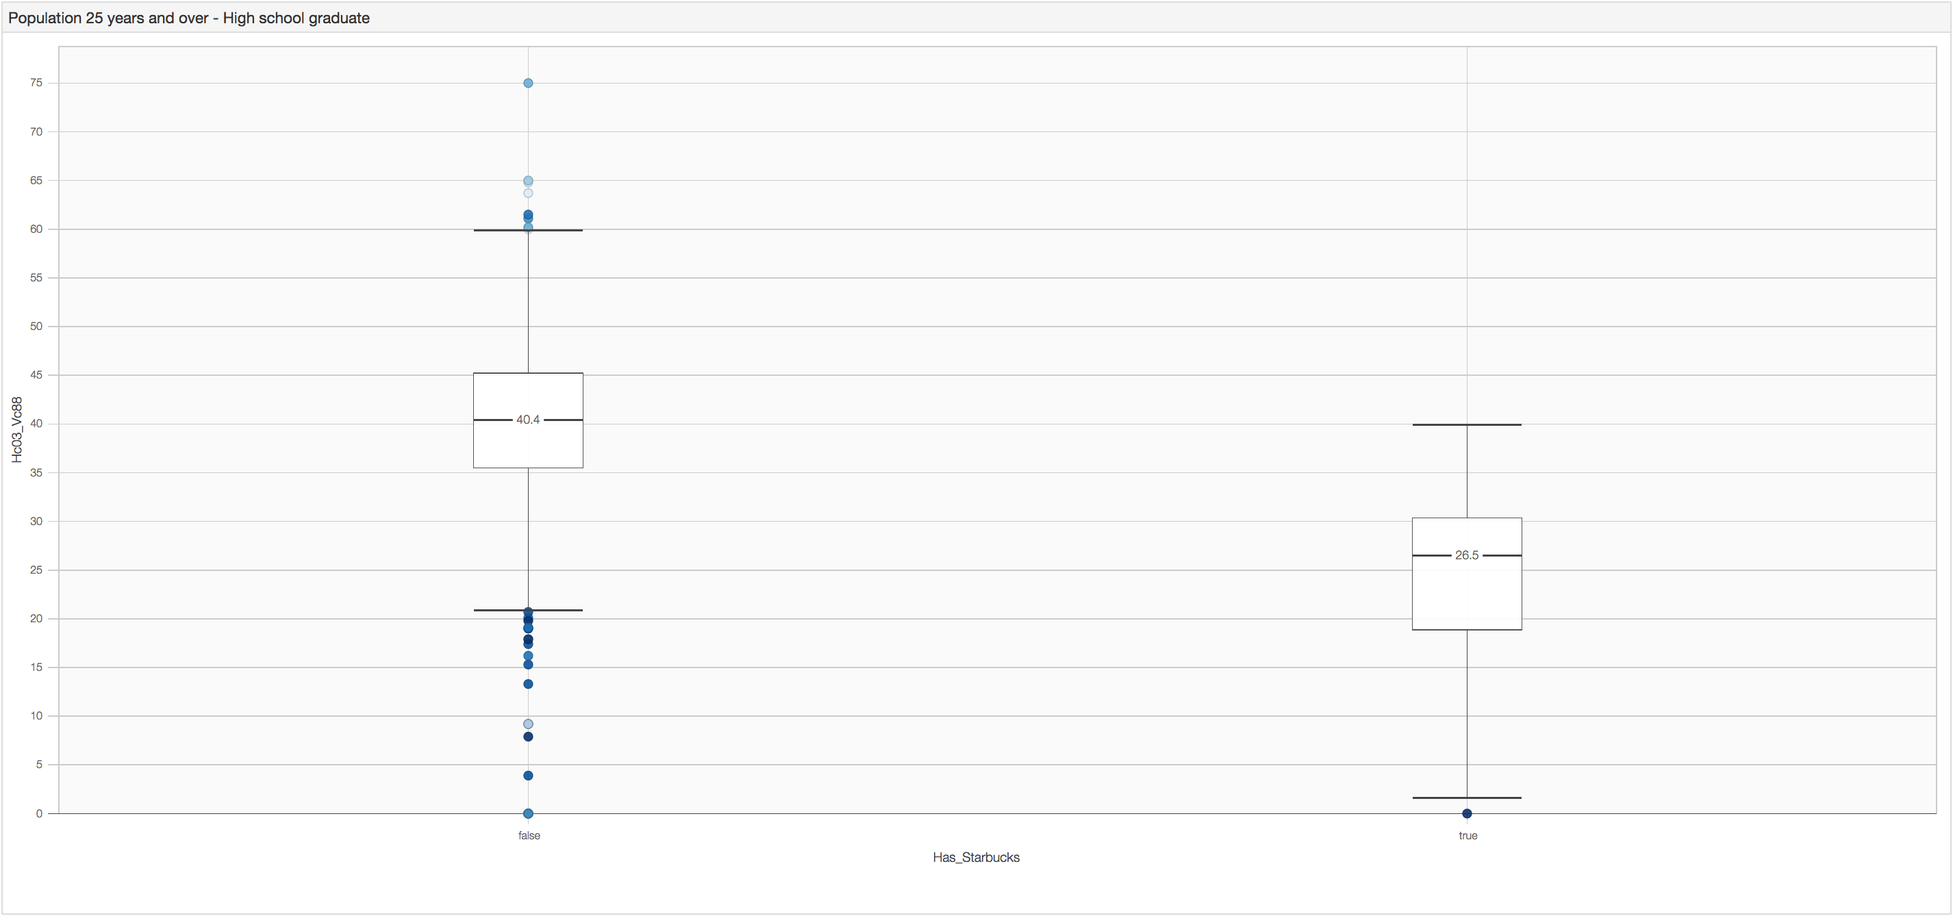
High School Diploma

Slide 12
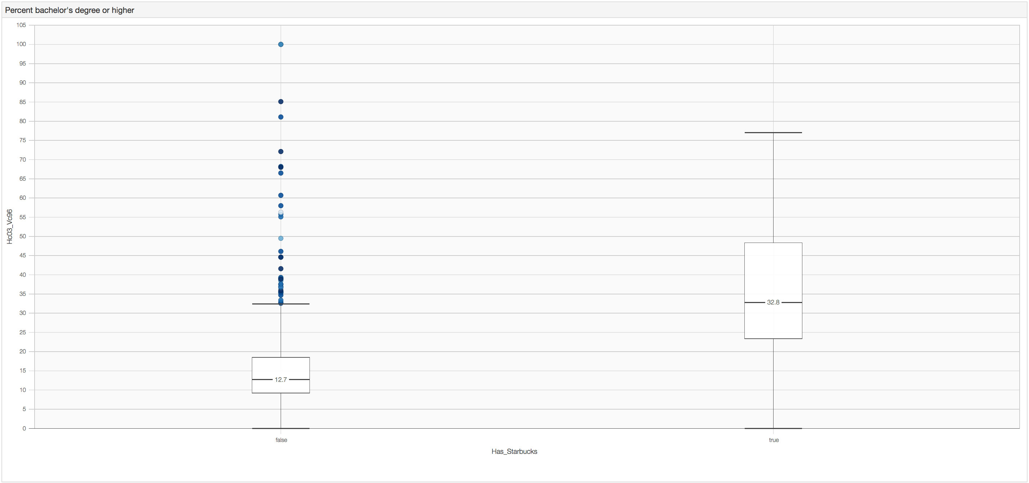
College Degree

Slide 13
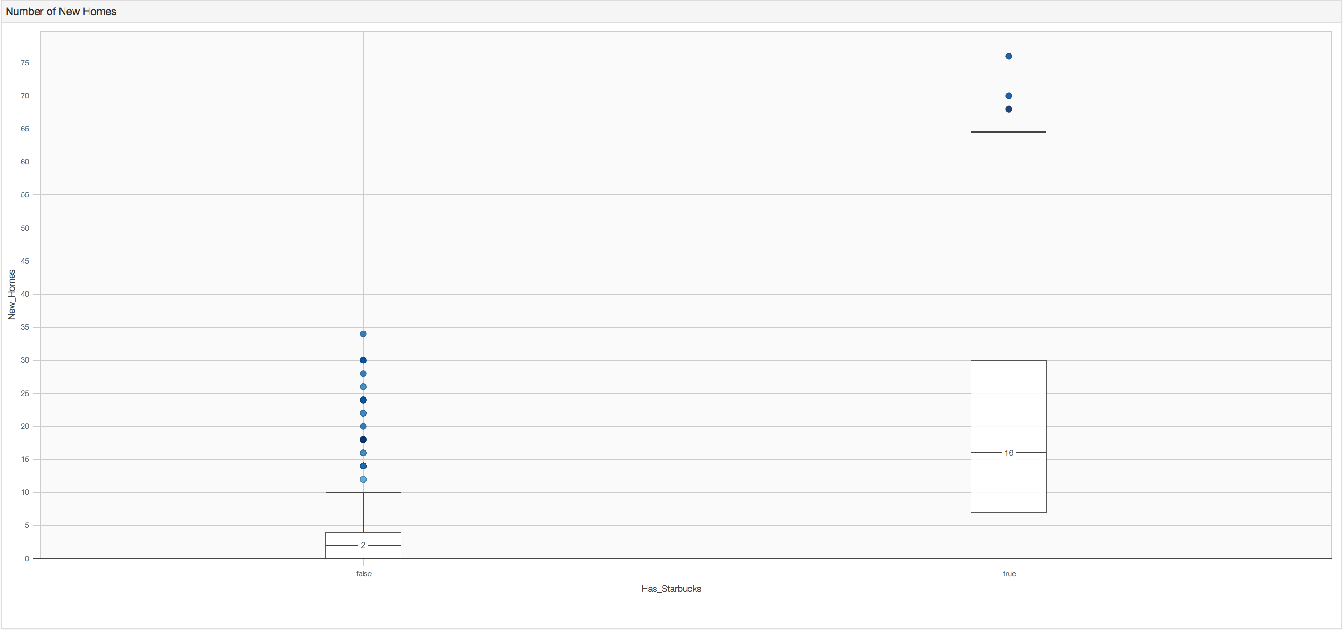
Number of New Homes

Slide 14
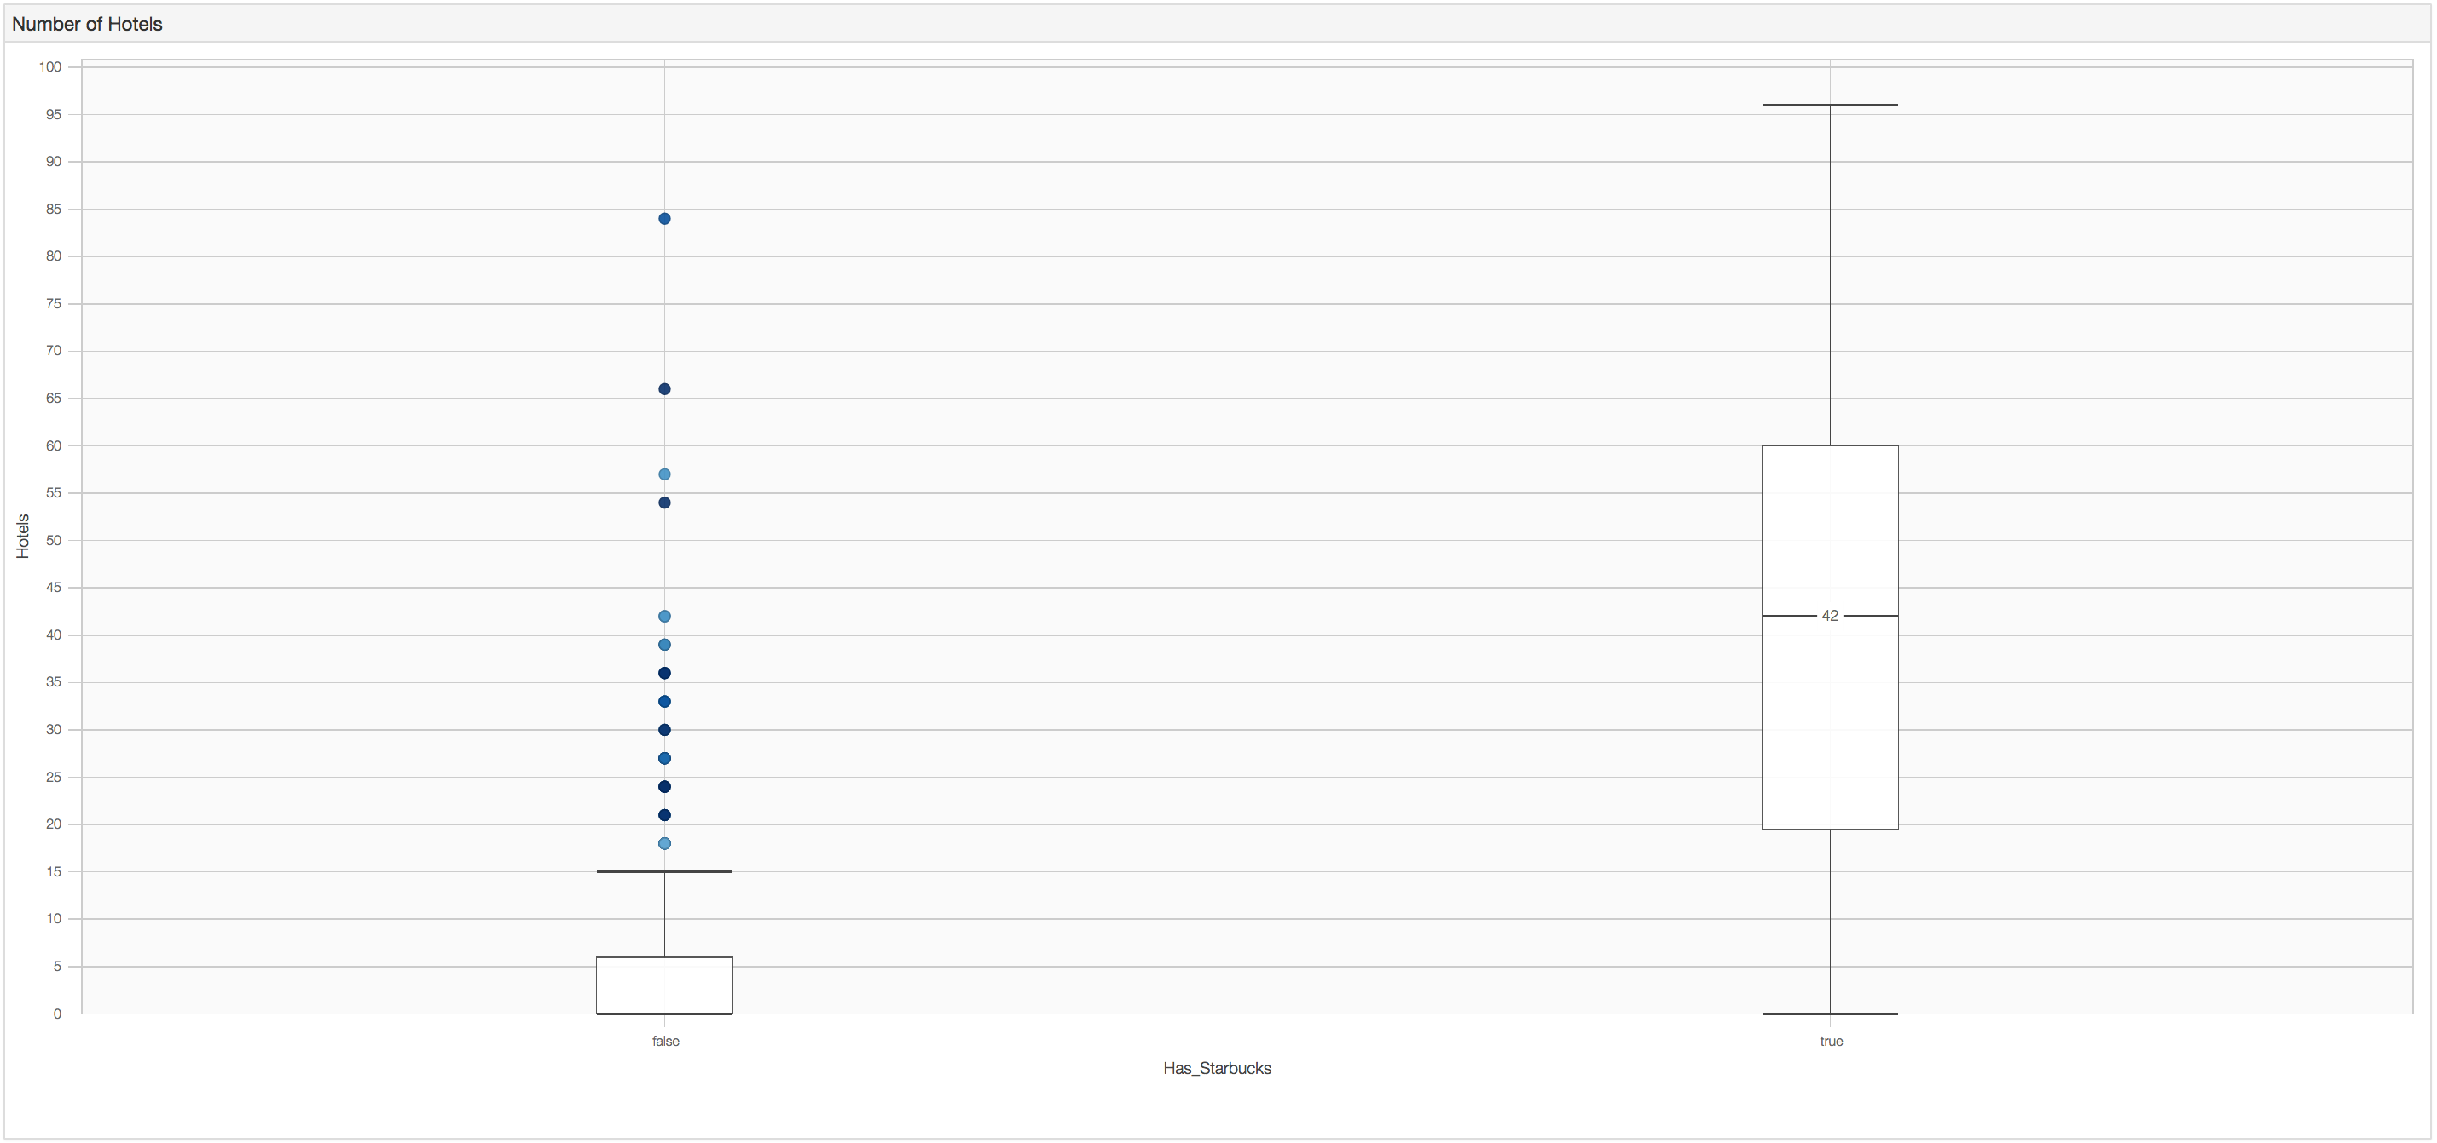
Number of Hotels

Slide 15
Regressions to Determine Which Zip Codes are Best
• Multiple Linear Regression
• Quantile Regression (more on this later)
• Logistic Regression

Slide 16
Multiple Linear Regression, to Determine What is Significant
Adjusted R²: 0.596
coef std err t P>|t|
Intercept 0.3586 0.118 3.045 0.002 new_homes 0.0104 0.003 3.199 0.001
Hotels 0.0286 0.002 14.282 0.000
HC03_VC88 -0.0107 0.003 -3.898 0.000
population_density 1.481e-05 1.42e-05 1.044 0.297

Slide 17
Logistic Regression
coef std err z P>|z|
Const -3.2080 0.033 -98.027 0.000
HC03_VC96 0.0588 0.001 62.877 0.000
HC03_VC88 -0.0988 0.002 -64.464 0.000
hotels 0.0832 0.001 75.188 0.000
new_homes 0.0946 0.001 73.499 0.000

Slide 18
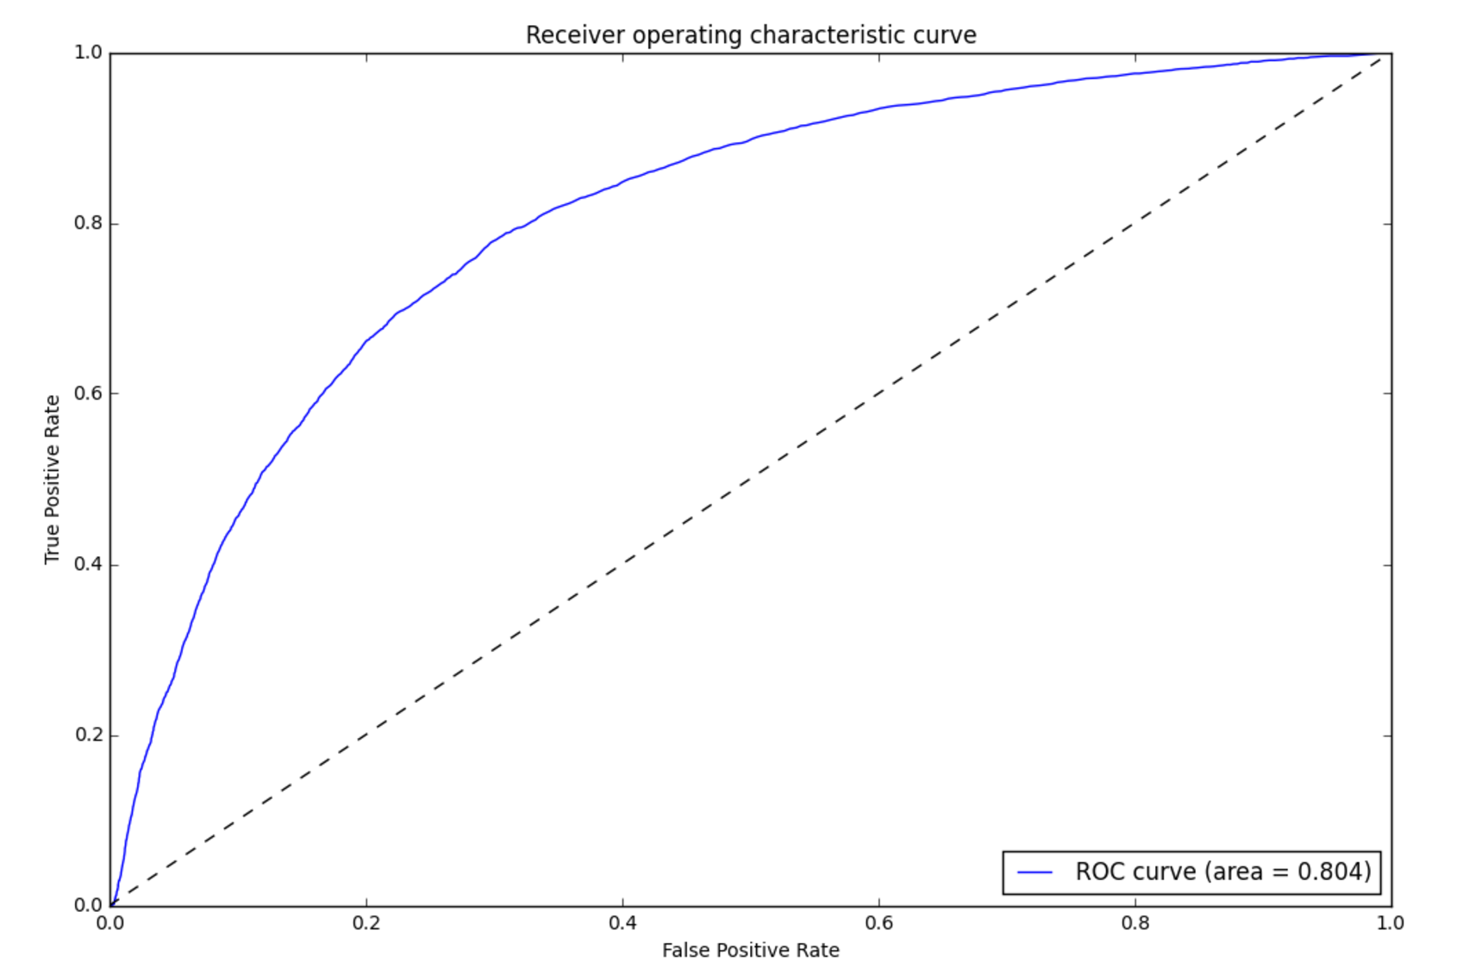
Logistic Regression

Slide 19
Logistic Regression as Store Location Strategy
• False positives can help determine what the best locations will be.
• The highest likelihood false positives are a great place to start
• 807 false positives with likelihood of 0.55 or greater

Slide 20
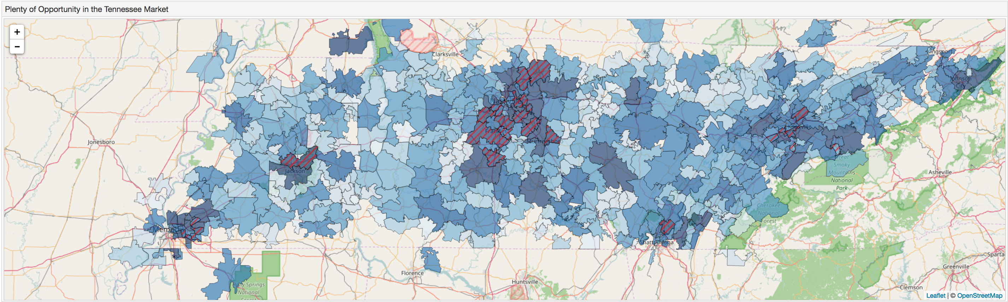
Tennessee: Microcosm of Nation's Coffee Patterns

Slide 21
Tennessee: Microcosm of Nation's Coffee Patterns
• More educated areas drink Starbucks
• Areas with more people (New Homes and Hotels) have more Starbucks

Slide 22
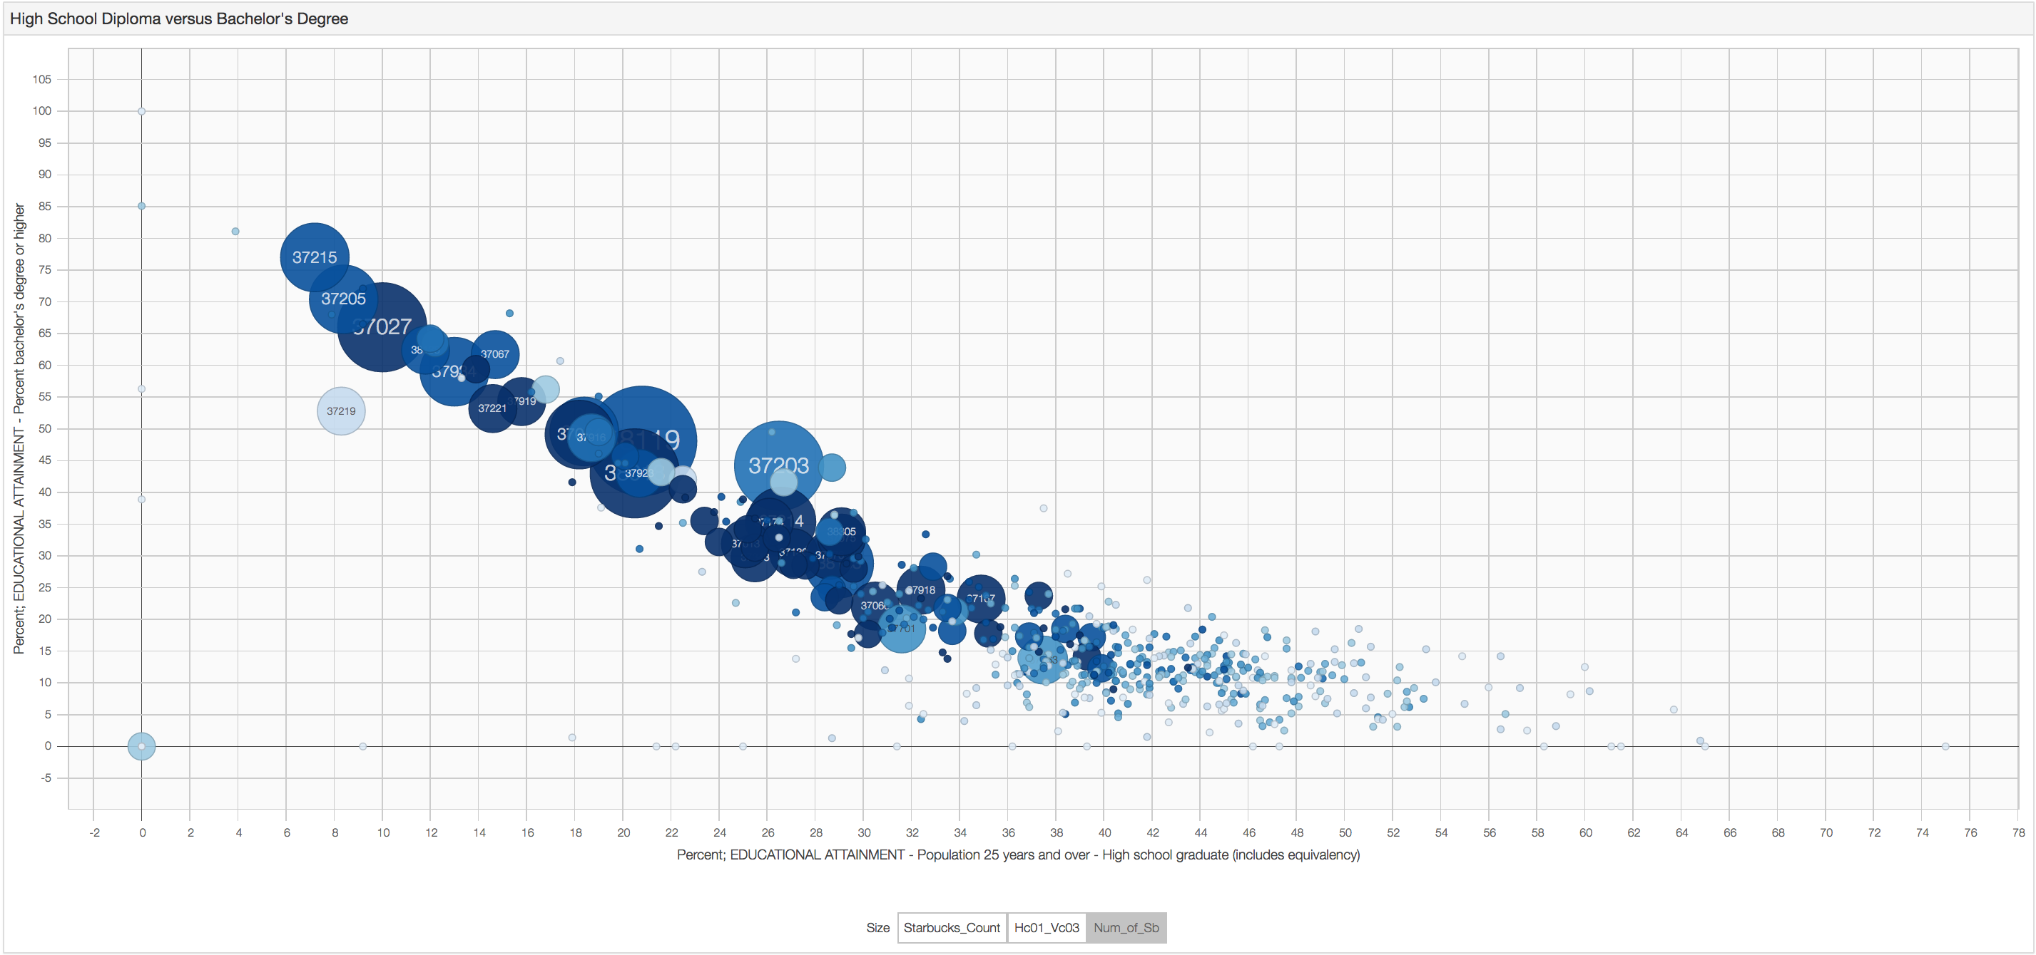
Education

Slide 23
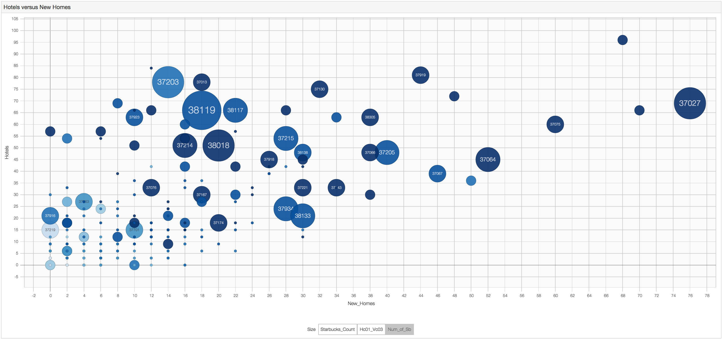
More People (New Homes, Hotels)

Slide 24
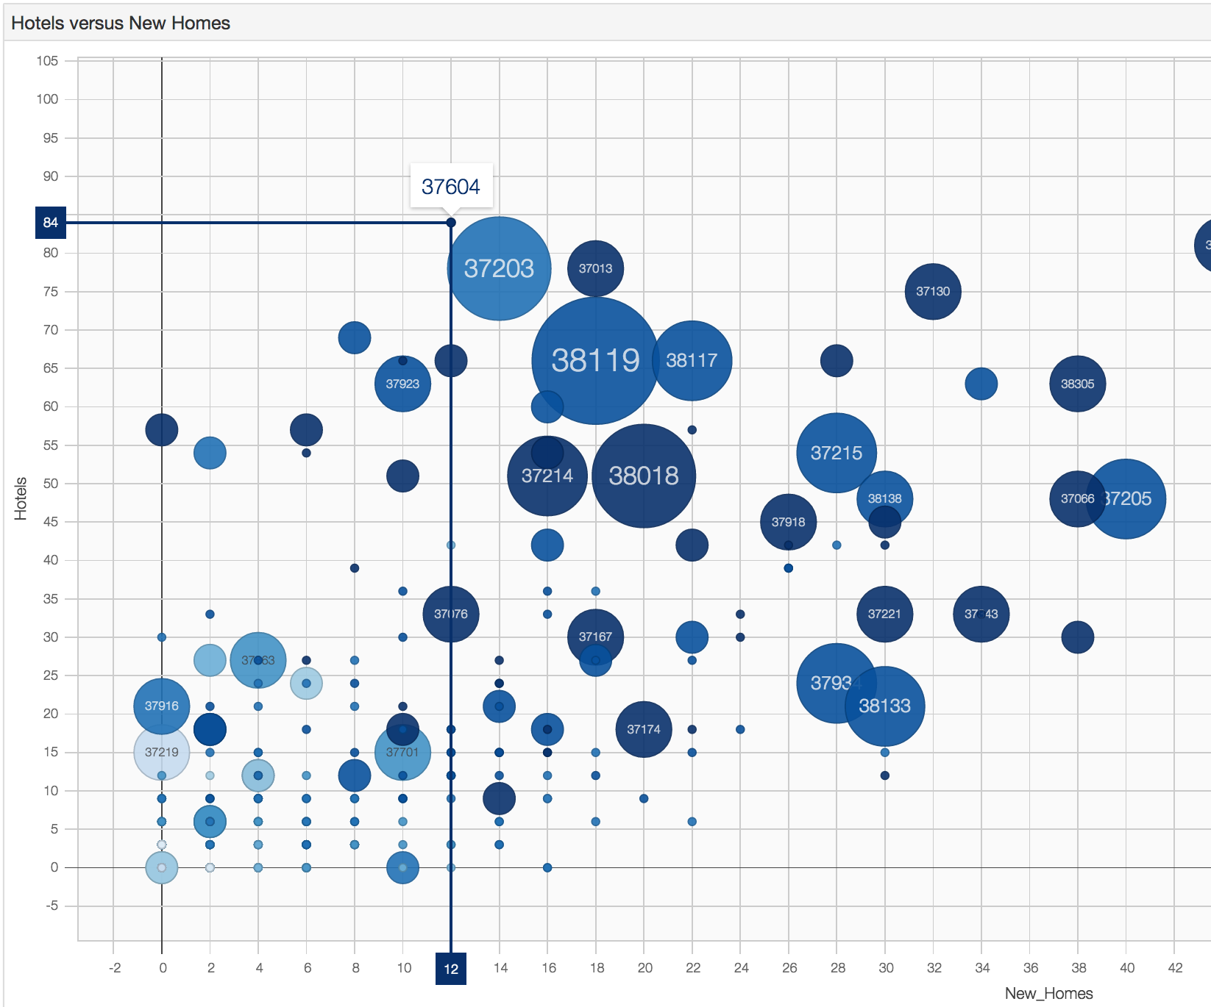
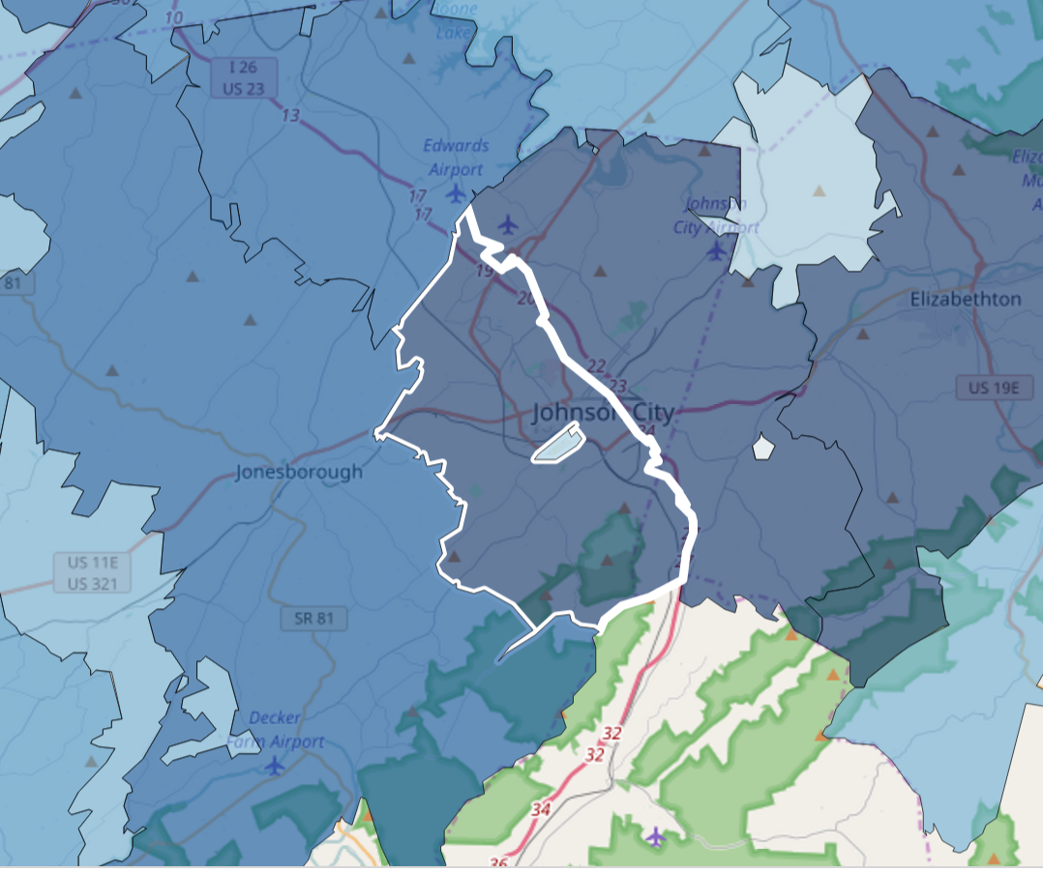
Top 5 Opportunities
37604 – Johnson City: No Starbucks Presence

Slide 25
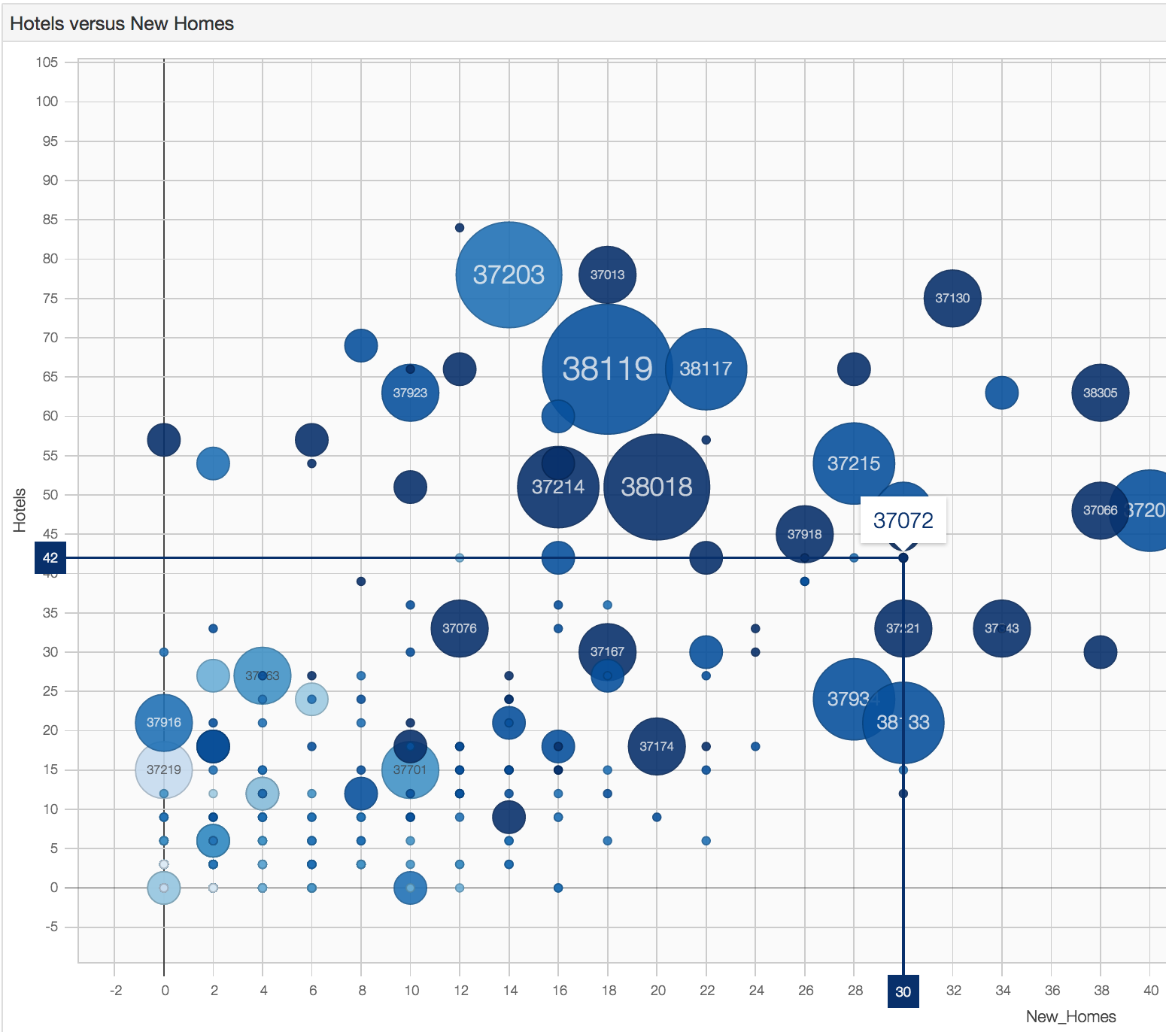
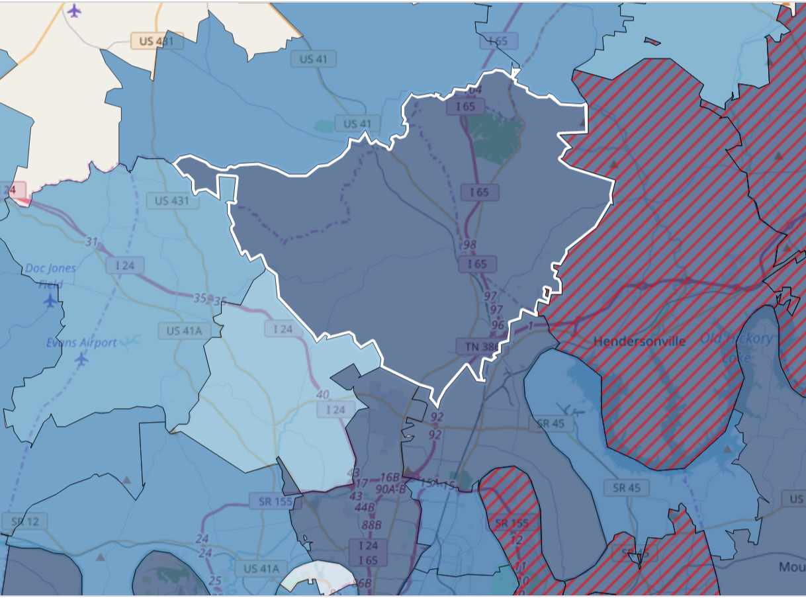
Top 5 Opportunities
37072 – Goodlettsville: 1 Starbucks Location

Slide 26
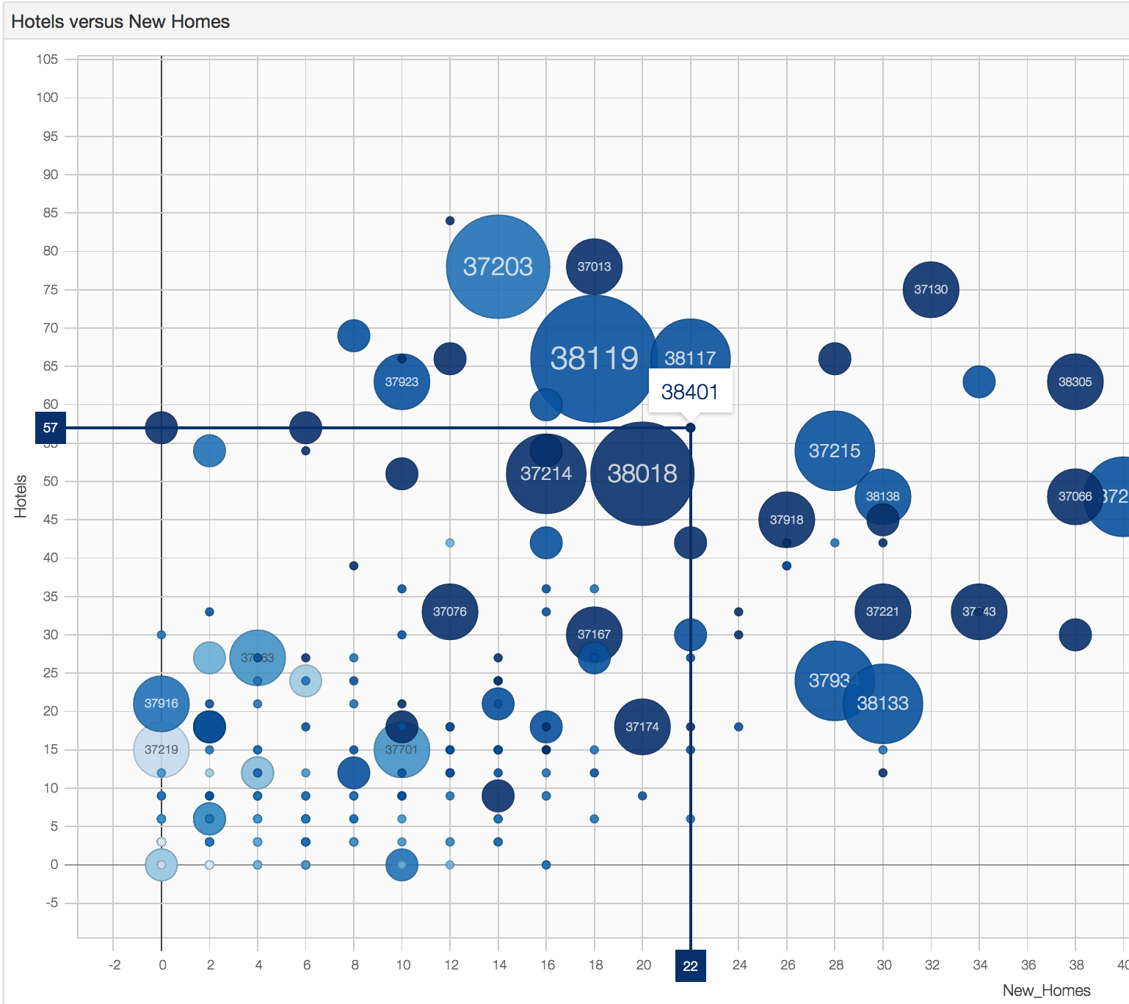
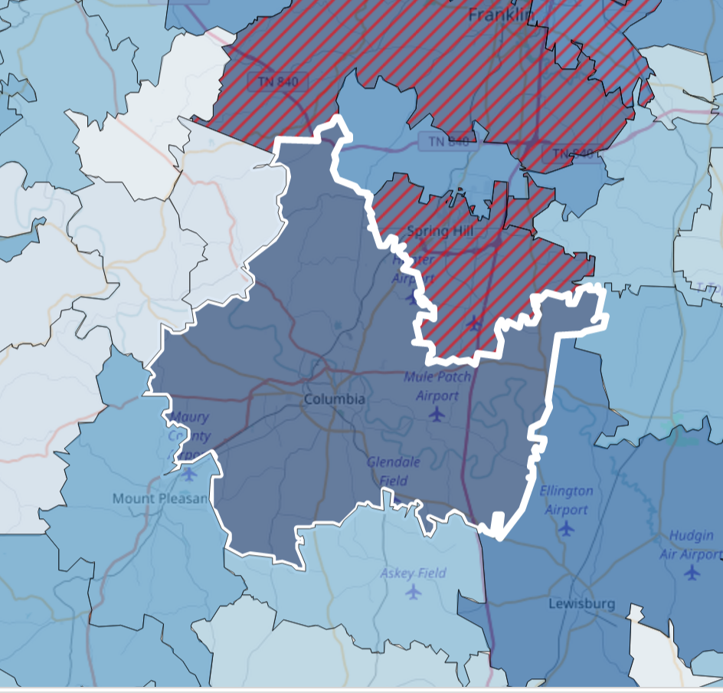
Top 5 Opportunities
38401 – Columbia: No Starbucks Presence

Slide 27
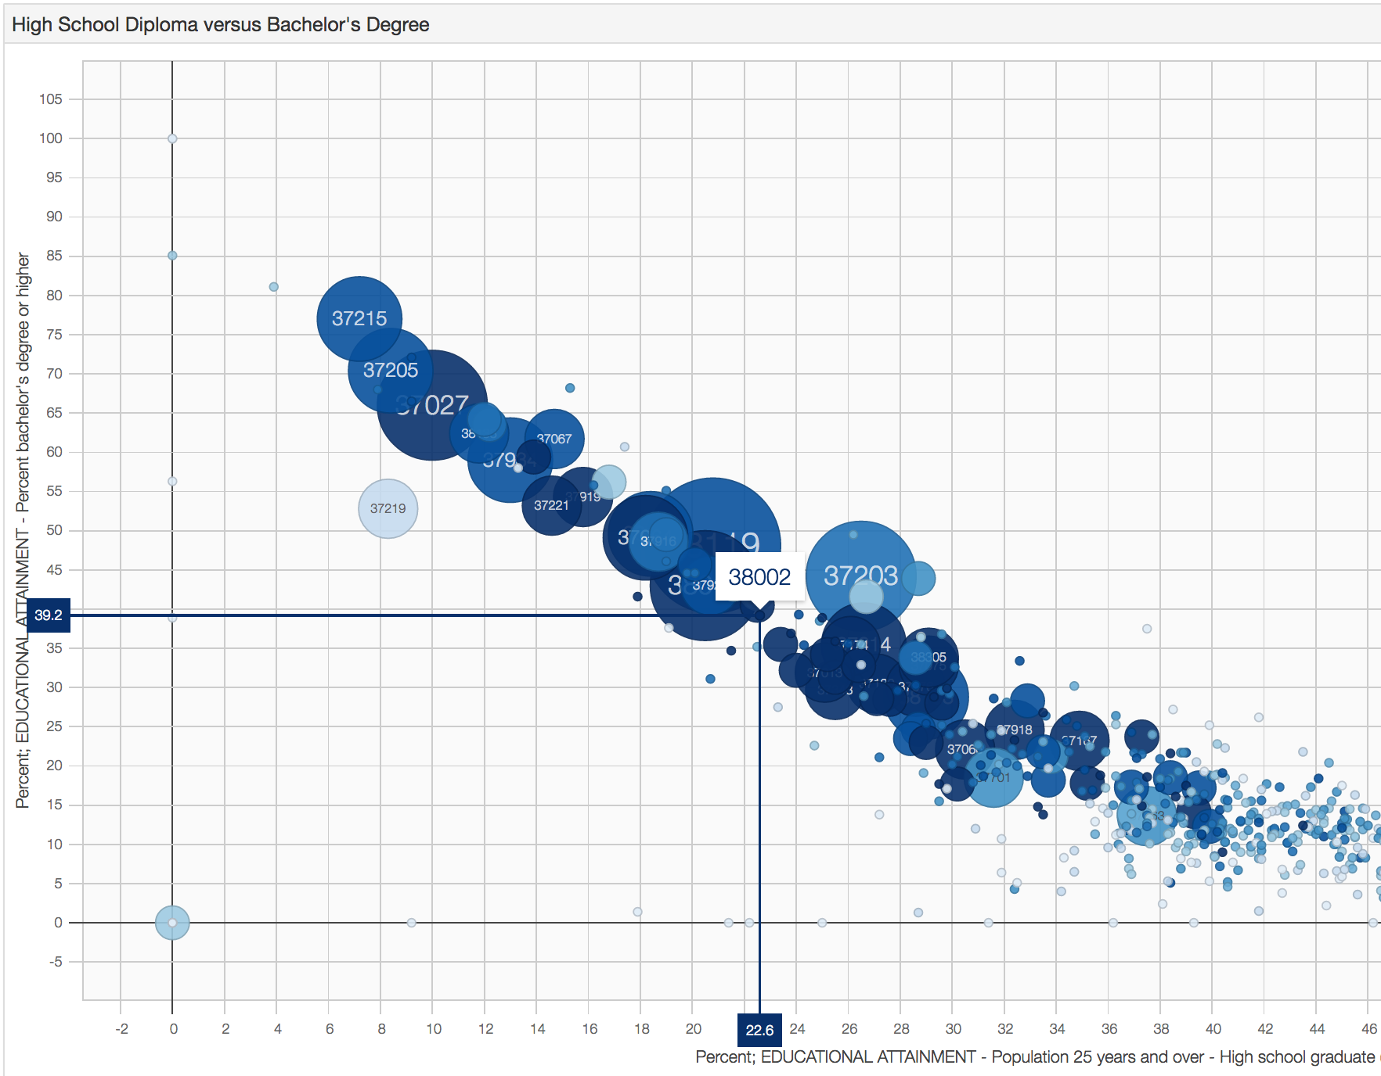
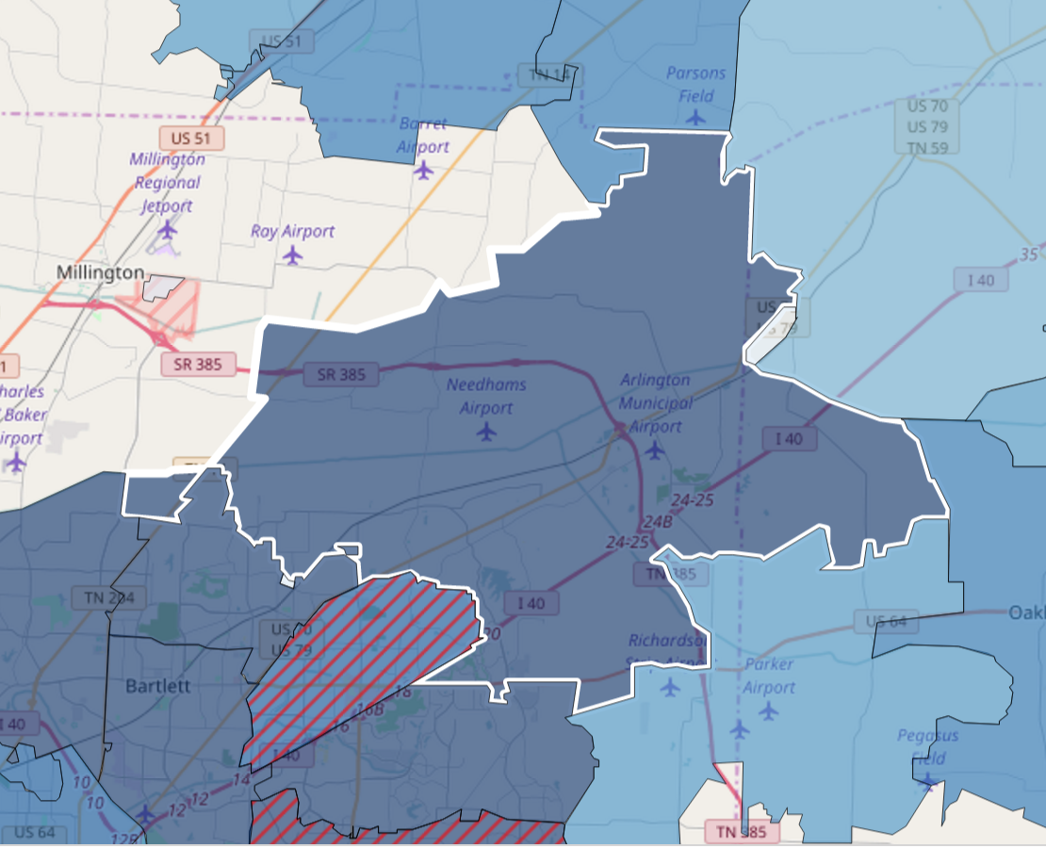
Top 5 Opportunities
38002 – Arlington: No Starbucks Presence

Slide 28
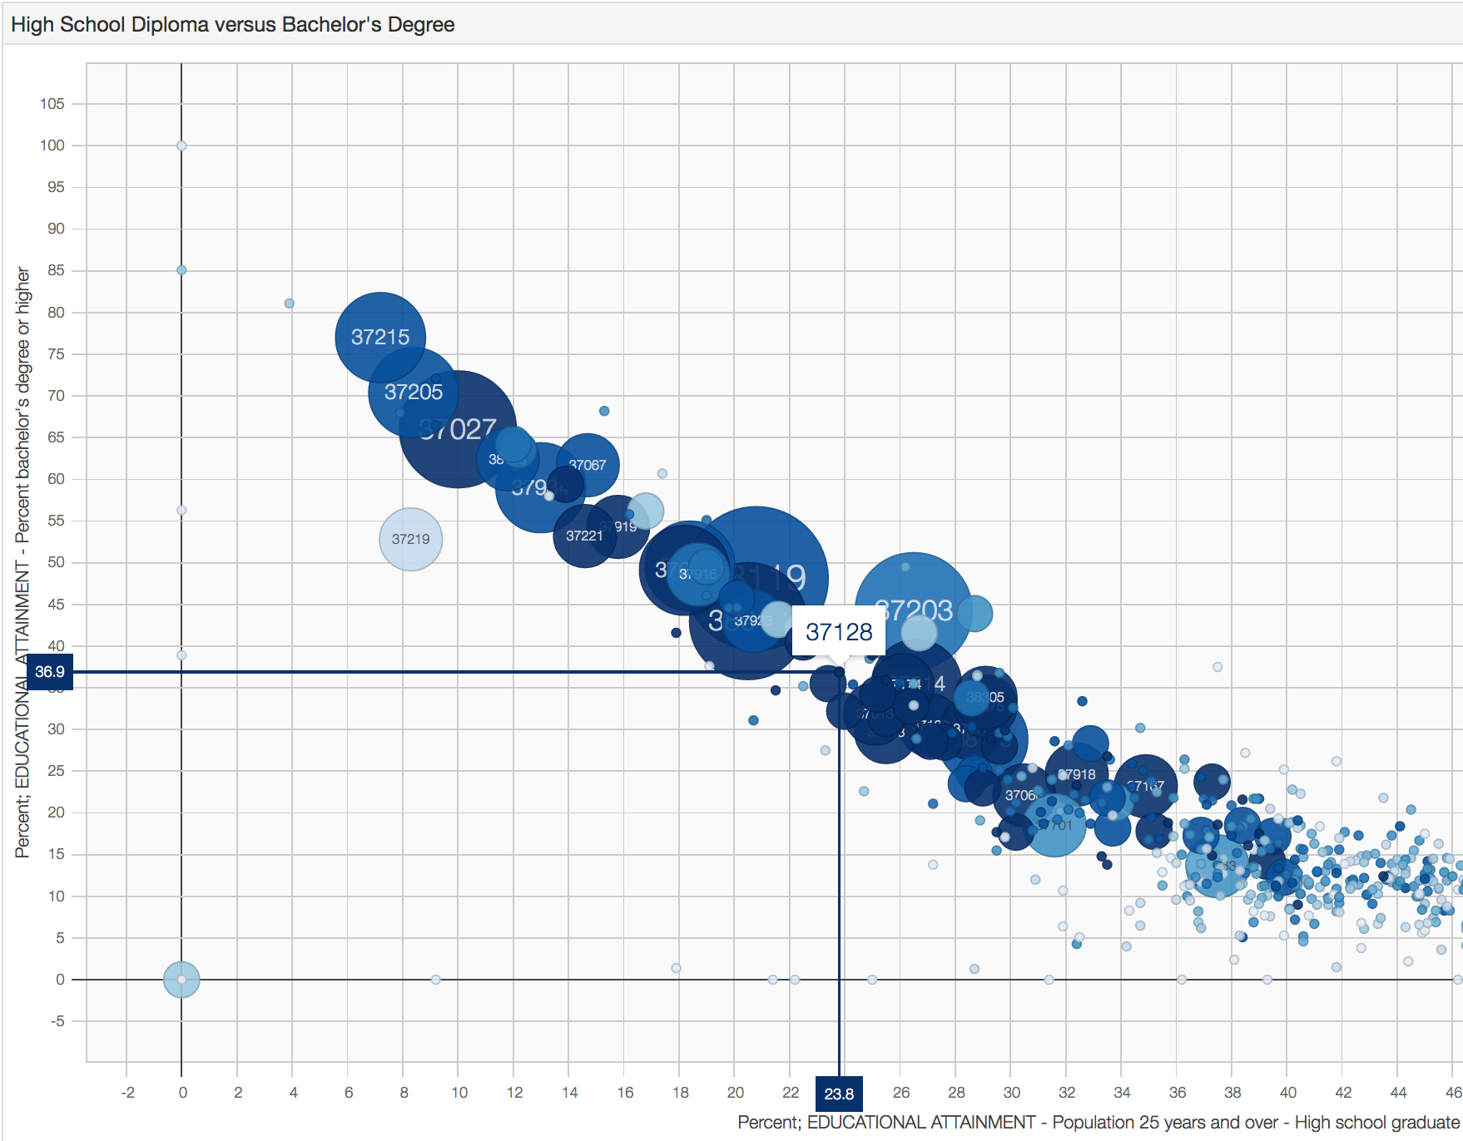
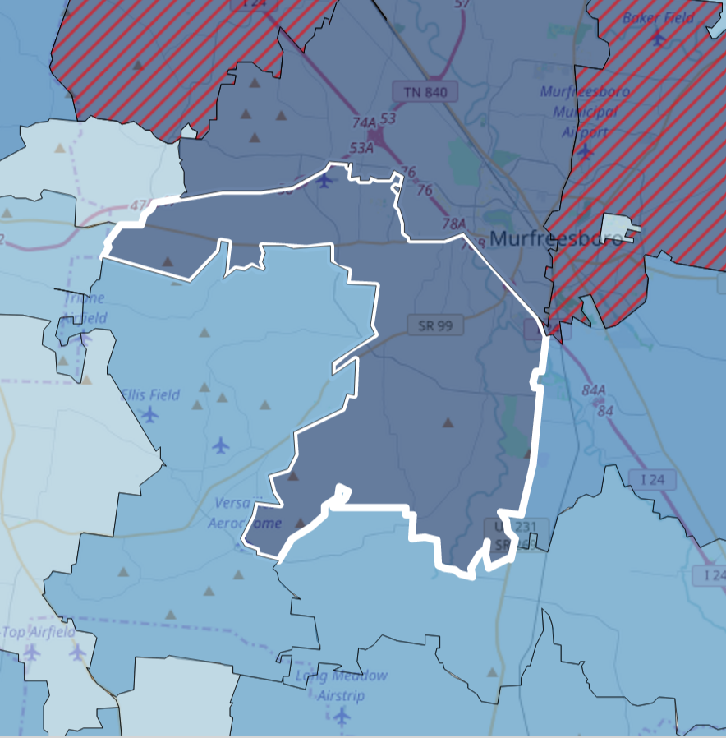
Top 5 Opportunities
37128 – Murfreesboro: No Starbucks Presence

Slide 29
Interesting Findings
• Quantile Regression produced same results as MLR with more precision as the quantile increased.
• For more robust results, use clustering algorithm (K-Means) before running regression.

Slide 30
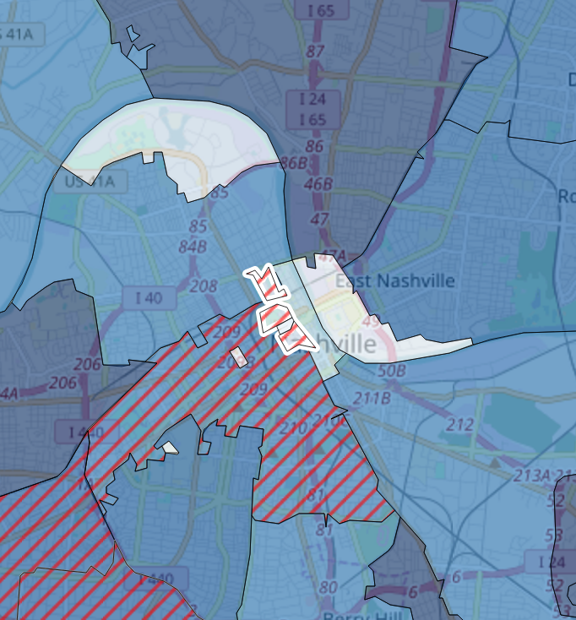
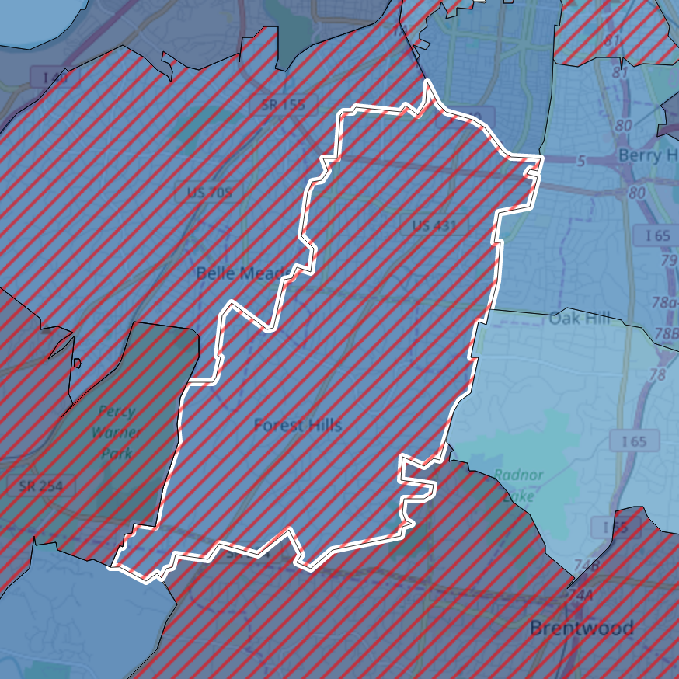
Limiting Conditions
• Every variable contained non-constant variance (and a lot of it).
• A state-by-state (paired with K-Means) analysis may produce better results.
• A state-by-state analysis because it’s hard to compare Montana and New York.
• Use K-Means because it’s hard to compare 37219 to 37215

Slide 31
Appendix
• Data preparation and clean up done with SQL, PostGIS, and Python
• Additional data used:
° Census’ County Business Patterns:
https://www.census.gov/programs-surveys/cbp.html
° FIPS to Zip Code crosswalk:
https://data.world/nrippner/fips-to-zip-code-crosswalk
° Census’ Zip Code Tabulation Areas (shapefiles):
https://www.census.gov/geo/maps-data/data/cbf/cbf_zcta.html
• Statistical Models were built with Python
• Graphs were built with Javascript libraries: D3.js & Leaflet.js, and are available interactively: https://s3.amazonaws.com/general-coffee/the_general/index.html
• All code available here: https://github.com/tmthyjames/general_prez
° Including coffee.sql and zcta.sh files to load import data and load Census shapefiles, and analysis.py for all models and
• Python dependencies: matplotlib, statsmodels, pandas, SQLAlchemy, numpy
• Database dependencies: PostgreSQL, PostGIS, psql (command line utility), shp2pgsql (command line utility)
• JavaScript dependencies: D3.js, D3plus.js, leaflet.js, leaflet-polygon.fillPattern.js

Slide 32
Bibliography
Muoio, Danielle. “Tesla is already showing how the insurance industry will be disrupted by self-driving cars”. Business Insider. Feb. 26, 2017. https://www.easybib.com/guides/citation-guides/mla-format/how-to-cite-a-website-mla/. Ap. 10, 2017.

